Slide 1
Automate Azure infrastructure
Like a boss!
Kamil Mrzygłód, Cloudyna 2019

Slide 2


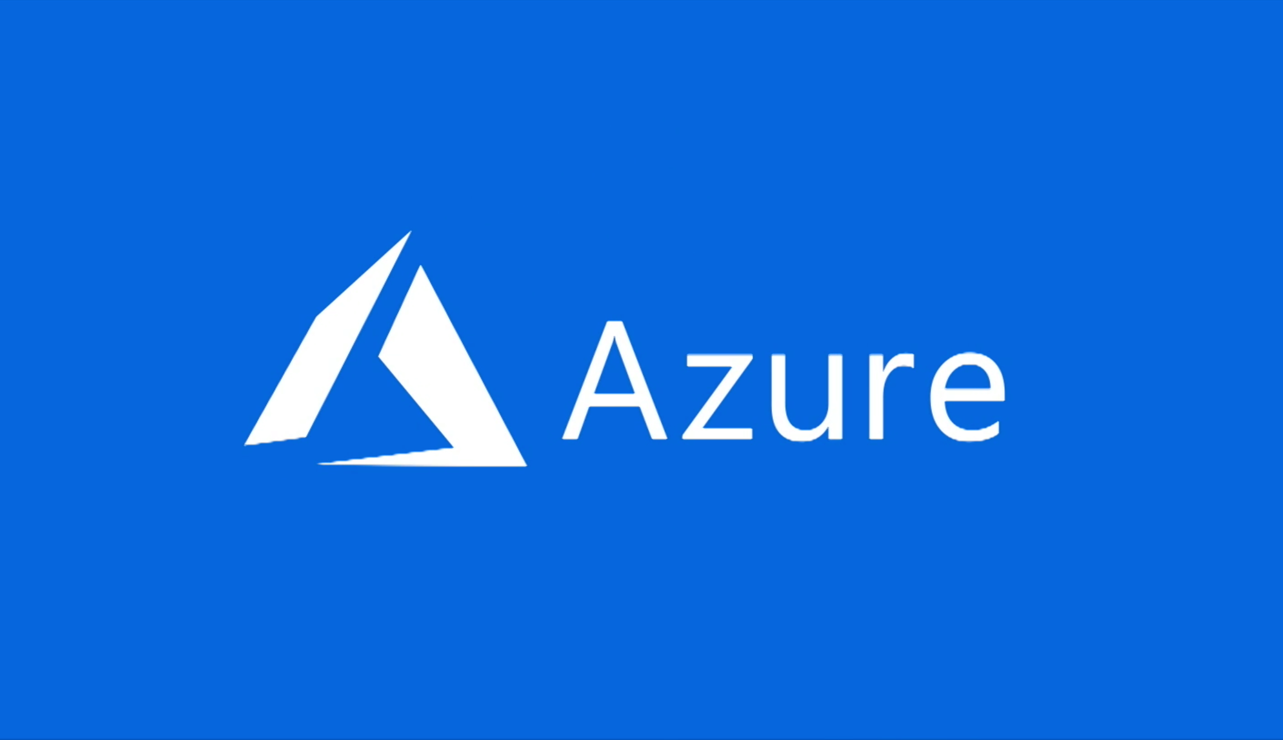



Slide 3
What will you learn?
What are multiple ways to deploy Azure infrastructure
How to make deployment process better
What can be done to enhance deployments
Where to search for help

Slide 4

Architecture vs Infrastructure

Slide 5


Slide 6


Slide 7
Wrap up

Slide 8
Azure Resource Manager
Our contact point with Azure

Slide 9
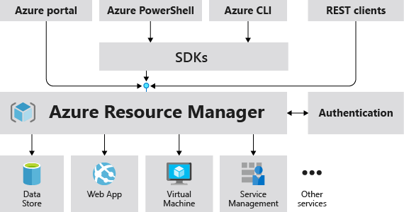

Slide 10
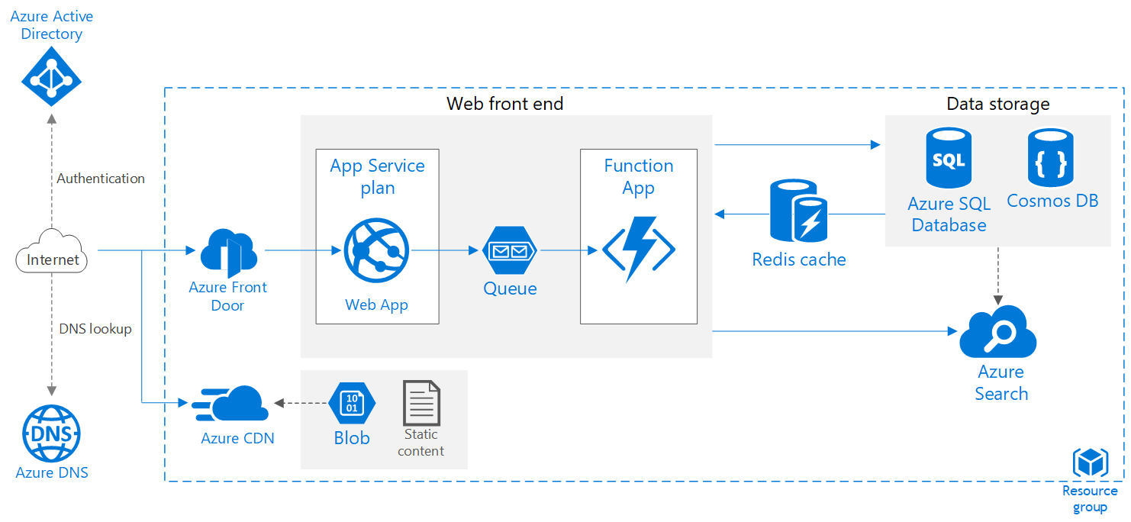

Slide 11
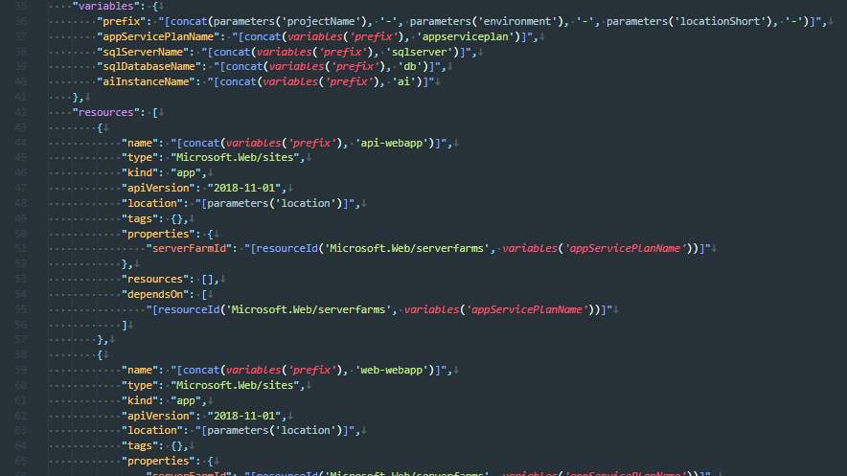

Slide 12
What’s next?

Slide 13
ARM Template
Native way infrastructure deployment in Azure

Slide 14
Demo 1
ARM Template + Azure CLI

Slide 15
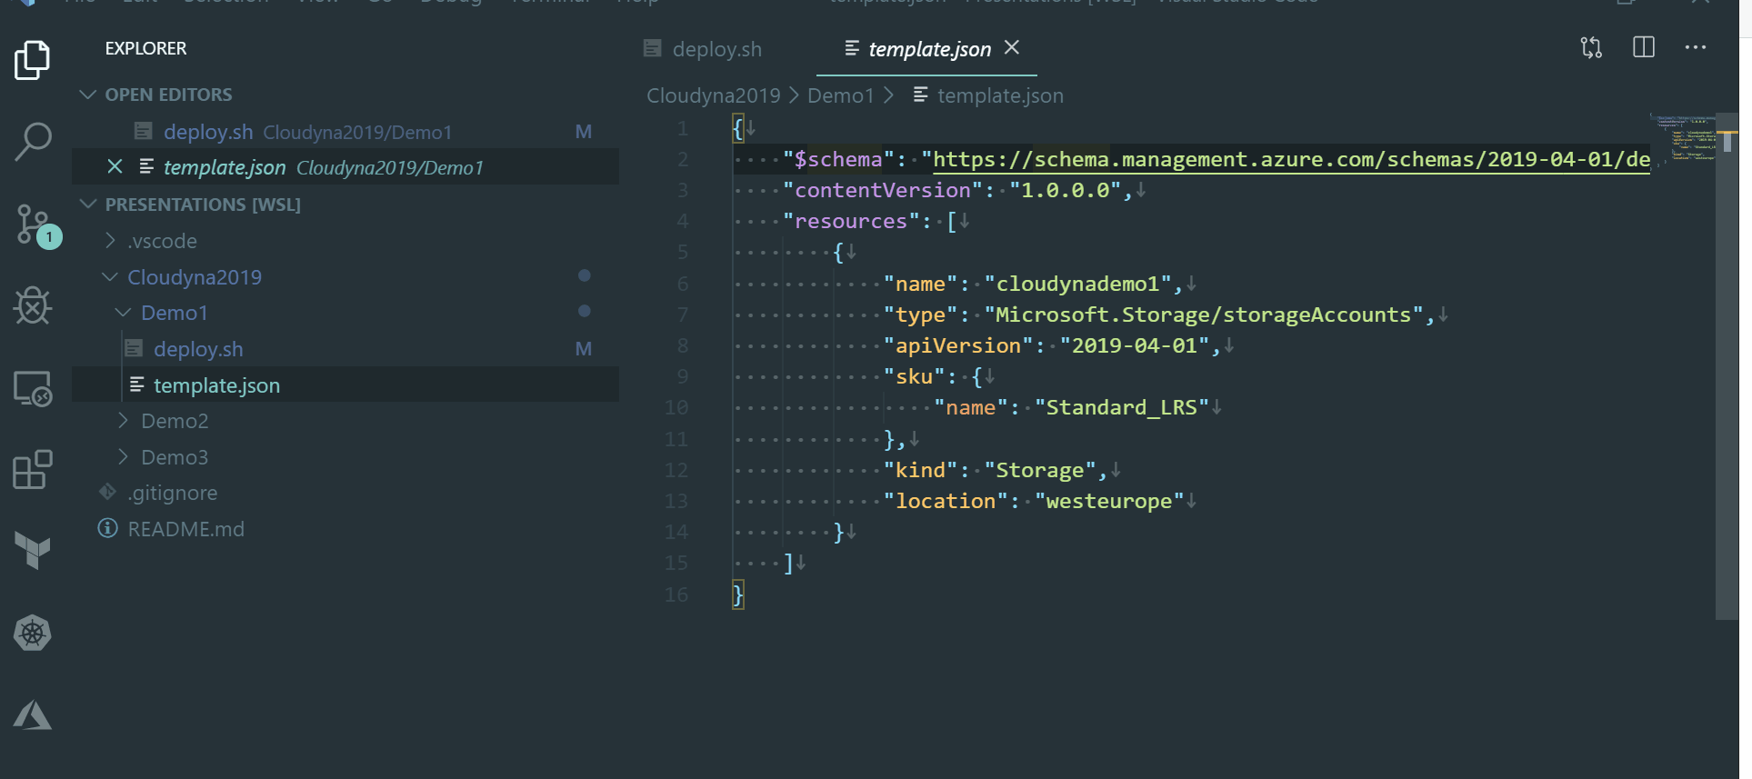

Slide 16
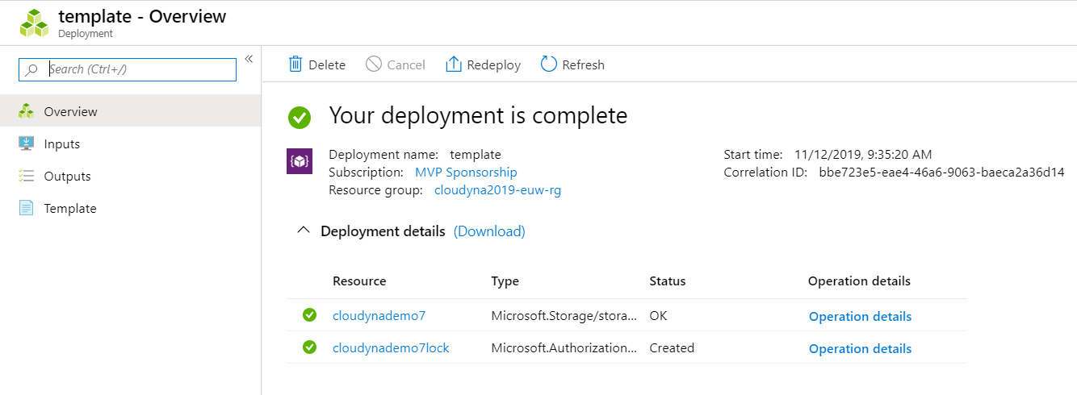

Slide 17
Conclusions
Declarative approach
Azure CLI as a runner
Requires upfront creation of a resource group
Run in the context of a resource group
Easy way to provide parameters via parameters files
Saved as deployment in Azure
3 different modes – Incremental, Complete and ValidationOnly

Slide 18
Azure CLI
Cross-platform, IT Pro friendly way ;)

Slide 19
Demo 2
Azure CLI

Slide 20
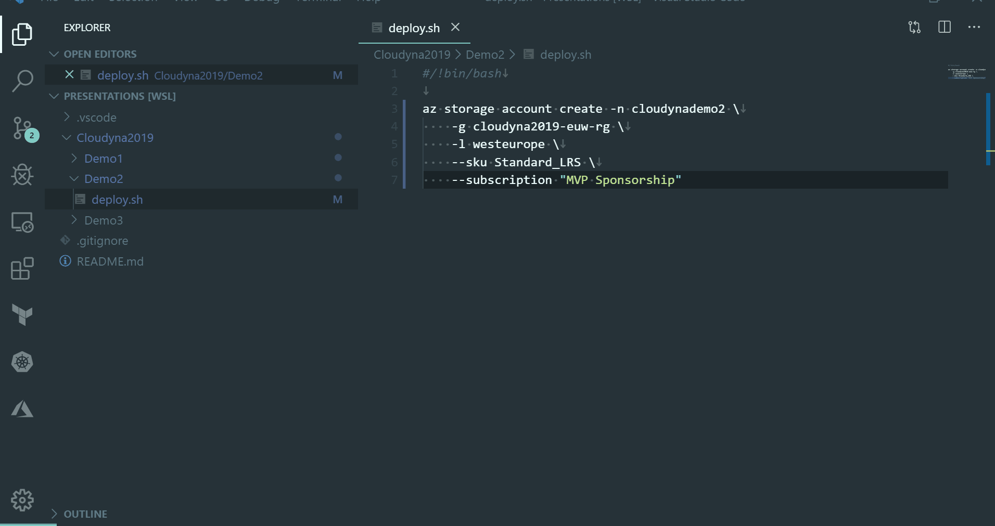

Slide 21
Conclusions
Imperative approach
Requires proper API implemented in Azure CLI
Easier way to introduce logic
Simpler, cleaner, more robust way of defining infrastructure

Slide 22
Fluent API
You see me rollin’, they hatin’…

Slide 23
Demo 3
Fluent API(aka Management SDK)

Slide 24
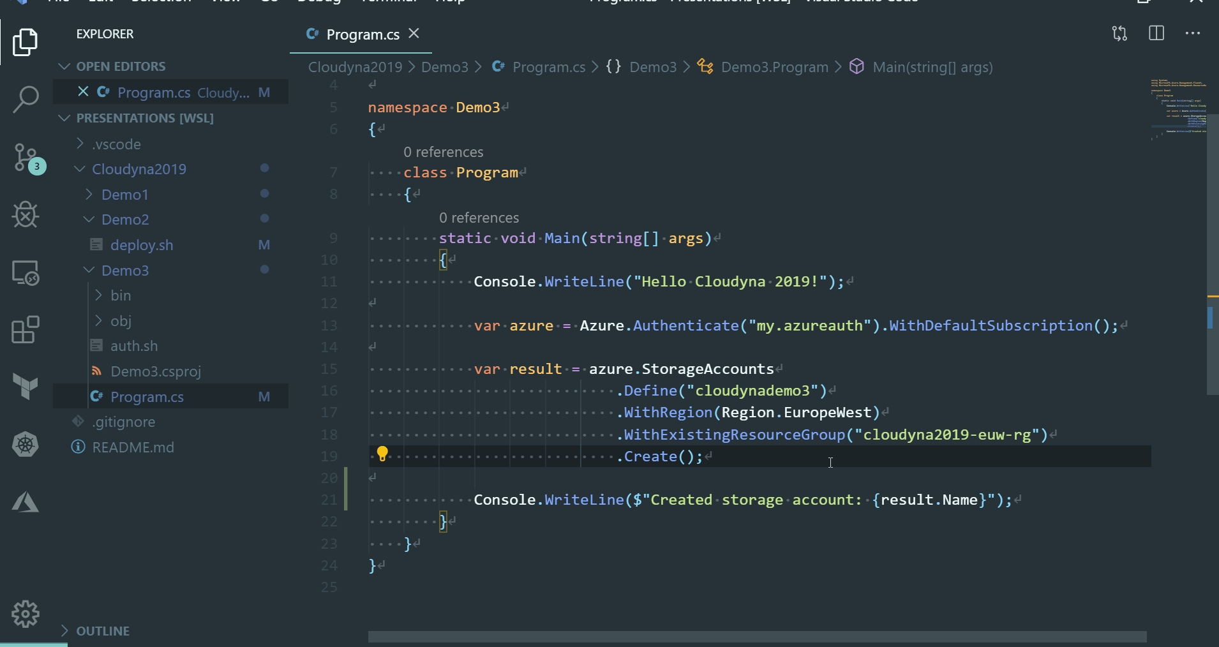

Slide 25
Conclusions
Imperative approach
Requires proper API implemented in the SDK
Requires particular language support
May not work on all platforms
Easy to incorporate into test suites
Much easier to understand by devs

Slide 26
Terraform
It’s a JSON! It’s a YAML! It’s an ARM template!

Slide 27
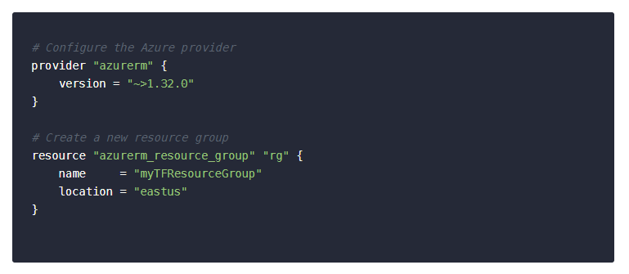

Slide 28
Demo 4
Terraform

Slide 29
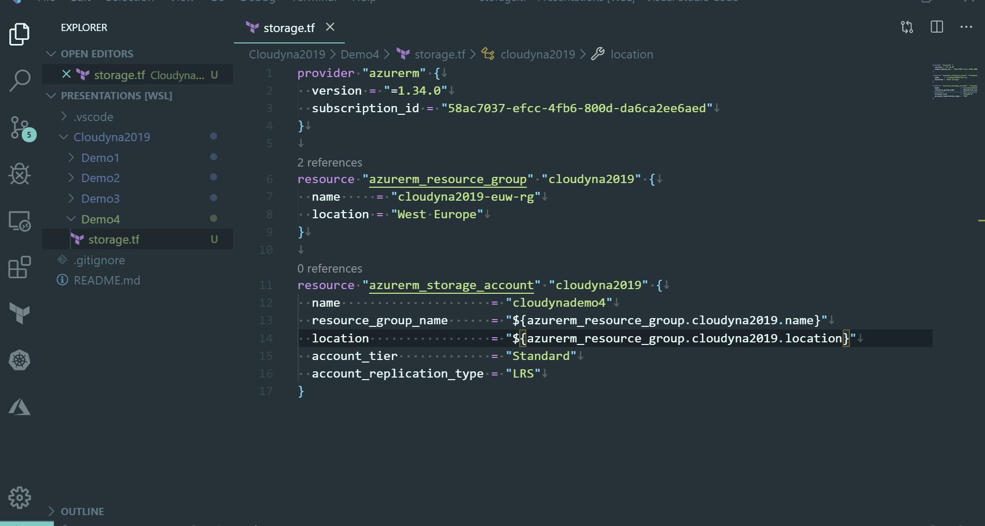

Slide 30
Conclusions
Declarative approach
Levarages HQL
Third-party
Requires special runner
Helps in understanding the impact of of the changes
In many ways similar to ARM templates(parameters, functions)

Slide 31
Pulumi
If a front-web developer scripted the infrastructure…

Slide 32
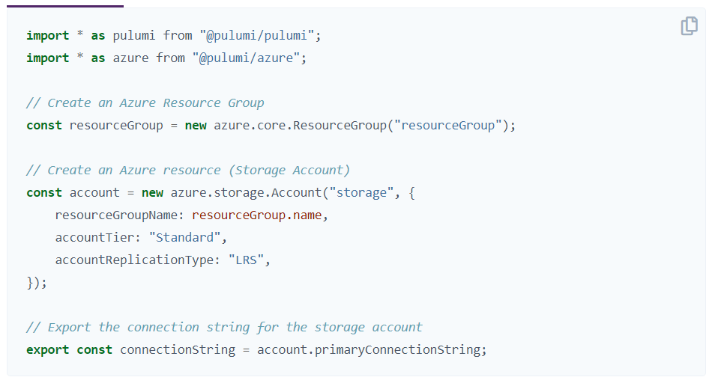

Slide 33
Demo 5
Pulumi

Slide 34
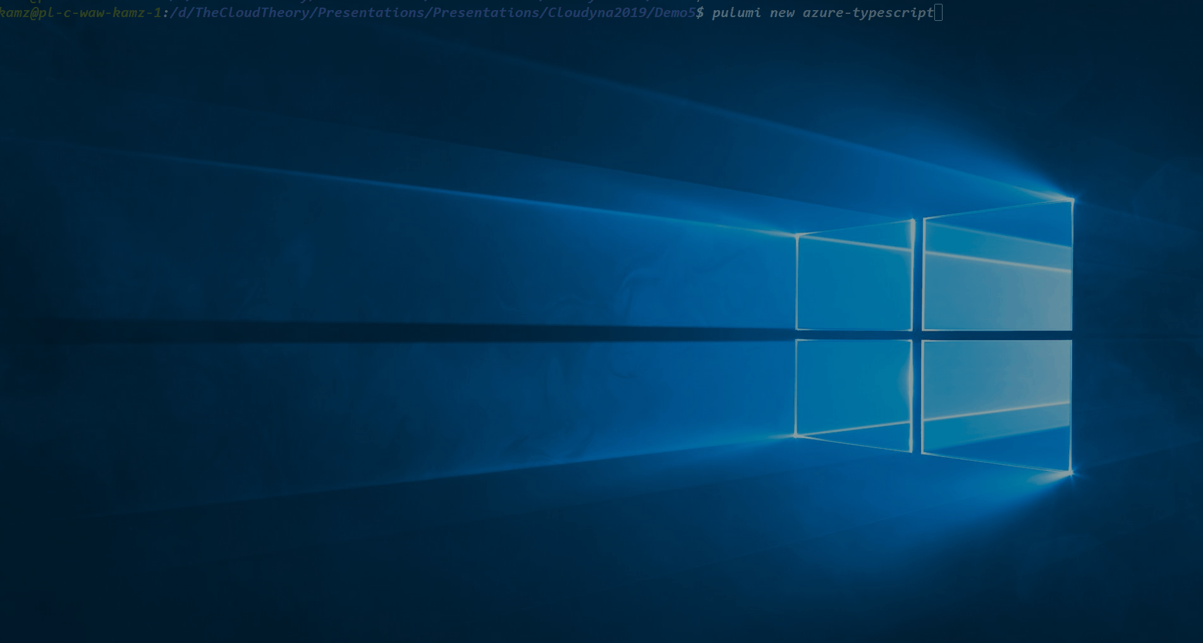

Slide 35
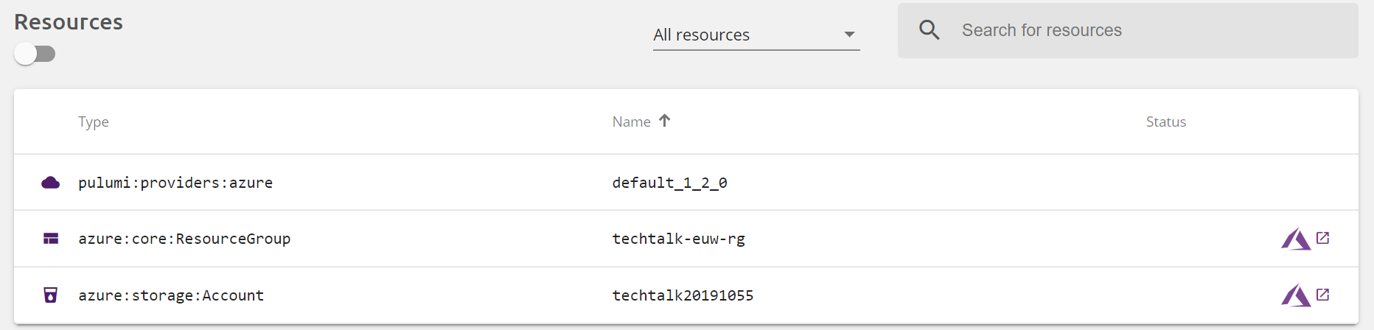

Slide 36
Conclusions
Declarative approach
Third-party
Requires special runner
Requires additional account
Similar to Management SDK

Slide 37
What do we have?
Declarative
Imperative
ARM Template
Terraform
Azure CLI
Fluent SDK
Pulumi

Slide 38
Enhance your deployments
Tags, locks, principals, roles, scaling rules…

Slide 39
Tag everything, everywhere…

Slide 40
Demo 6
Quering resources by tags

Slide 41
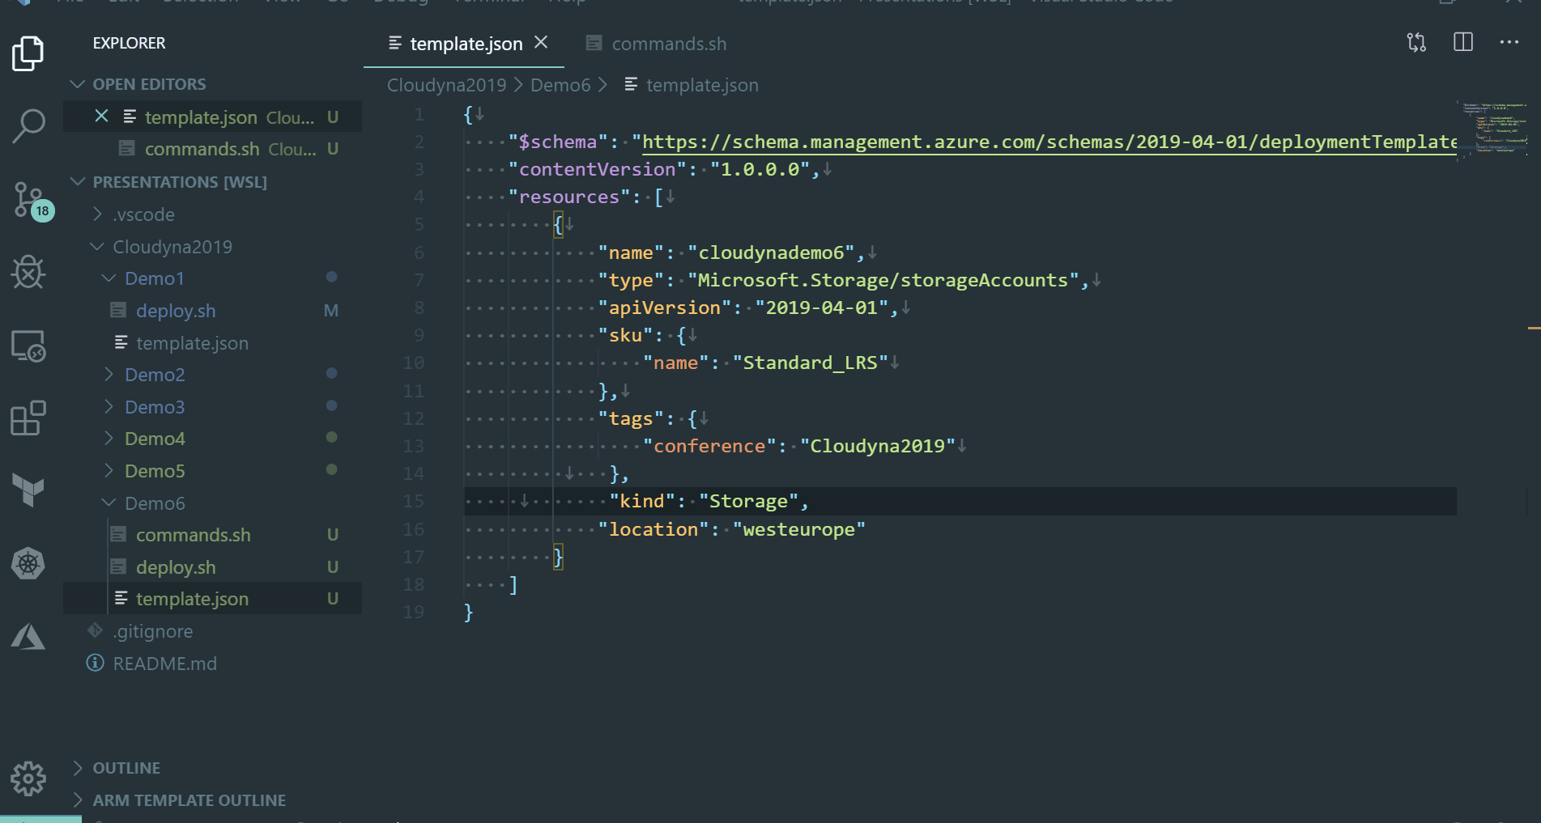

Slide 42
Locks to secure your infrastructure

Slide 43
Demo 7
Preventing changes / resources removal

Slide 44
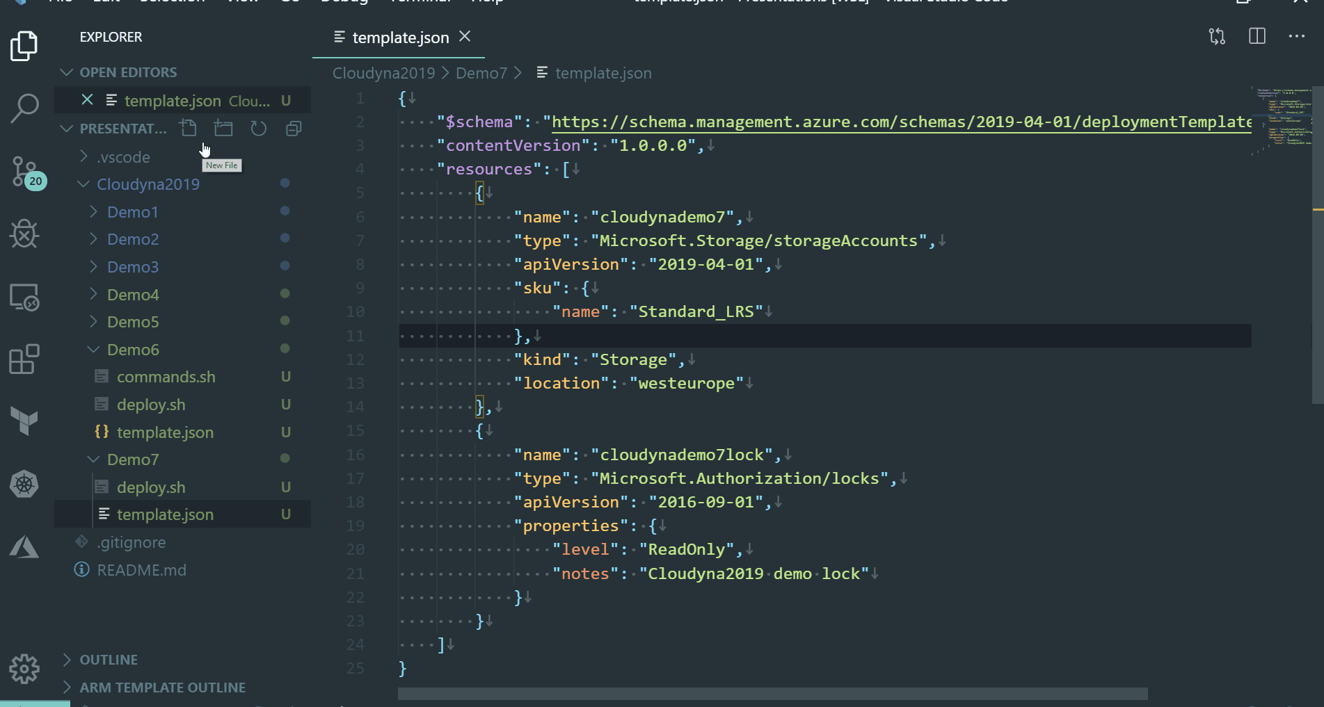

Slide 45
Ensuring access
Creation of service principals, roles assignment

Slide 46
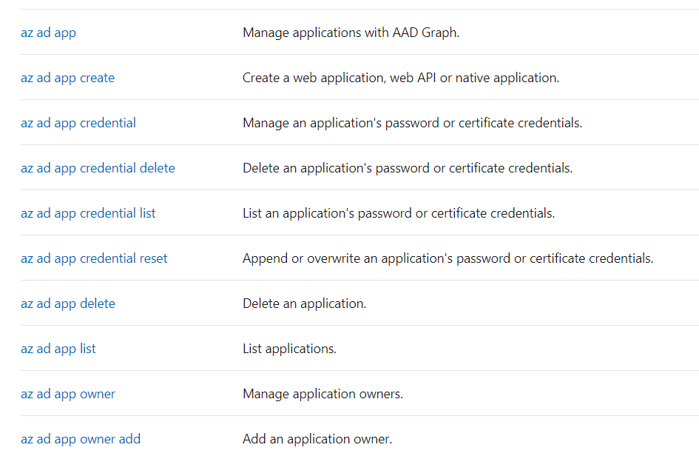

Slide 47
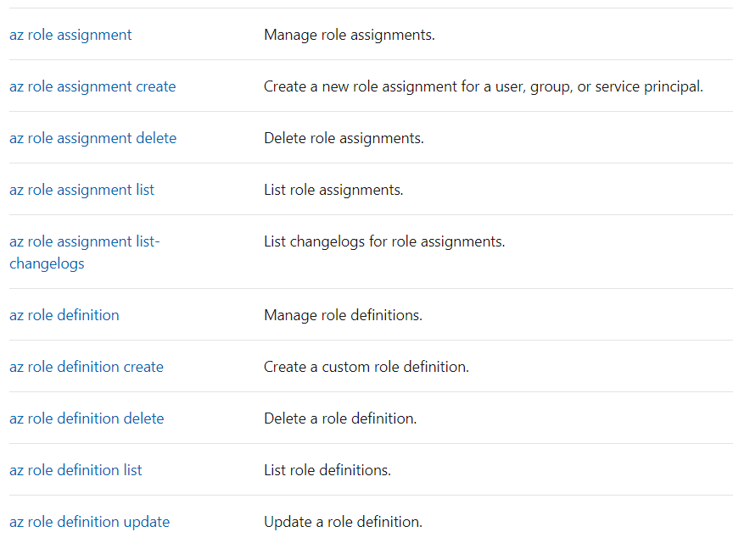

Slide 48
Scaling
Deploying autoscale and scaling rules

Slide 49
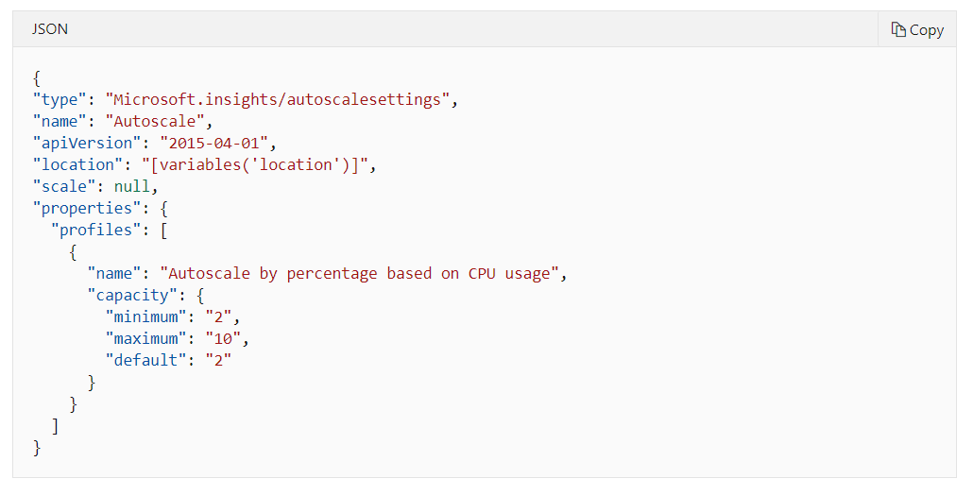

Slide 50
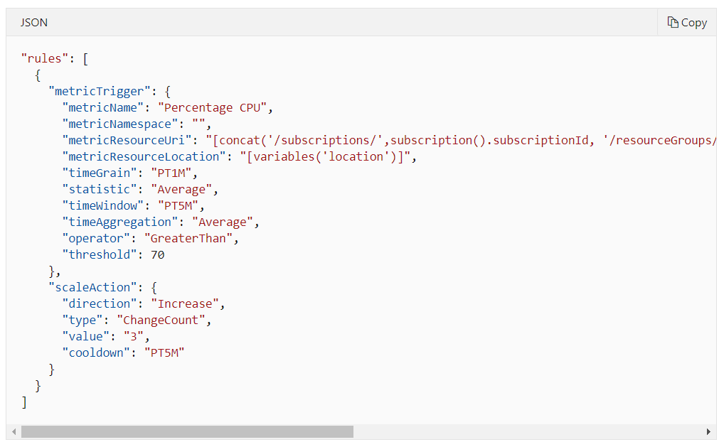

Slide 51
Choosing the right path
What is the best option?

Slide 52
It depends!

Slide 53
Declarative
ARM
Imperative

Slide 54
Third-party
ARM
Native

Slide 55
What’s more?

Slide 56
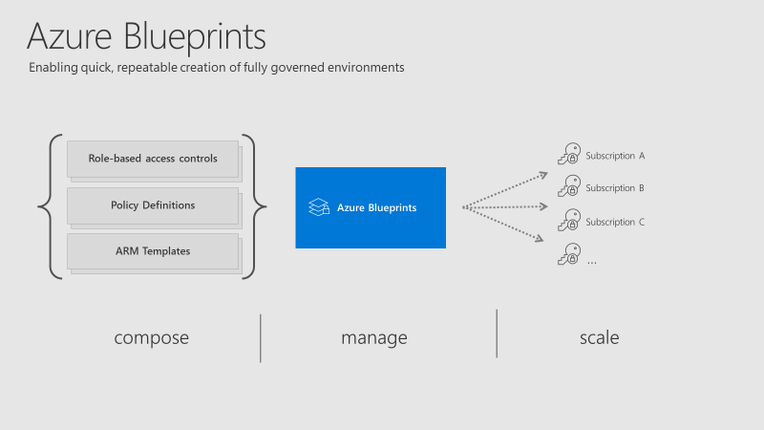
Azure Blueprints
Declarative way to orchestrate deployment of various resource templates and artifacts
Govern your resources from a single point
Combines ARM and Azure Policies

Slide 57
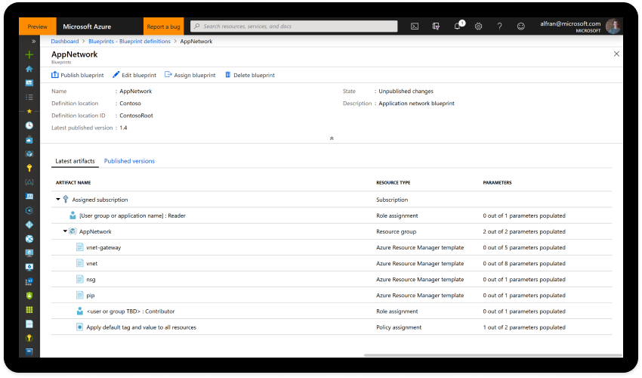

Slide 58
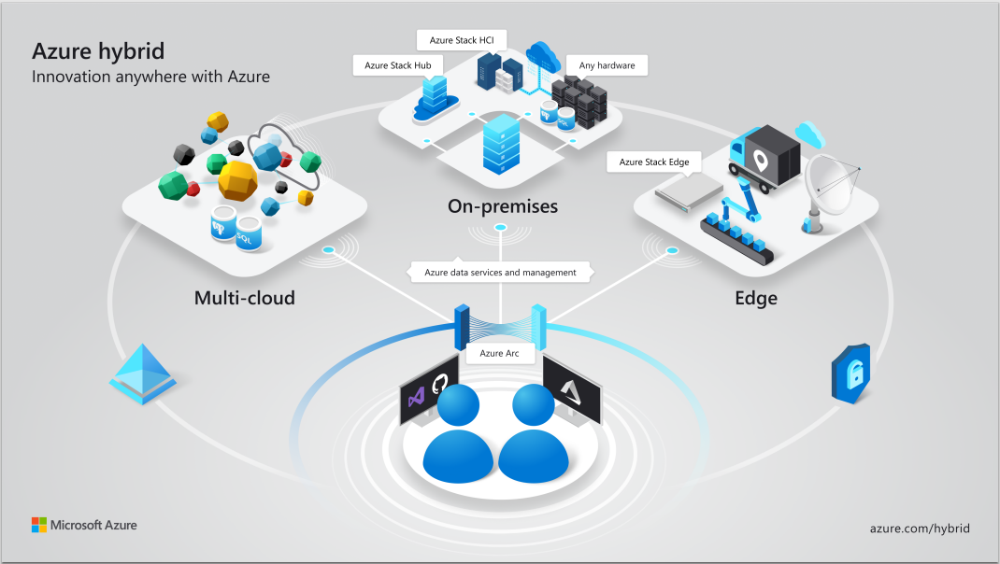

Slide 59
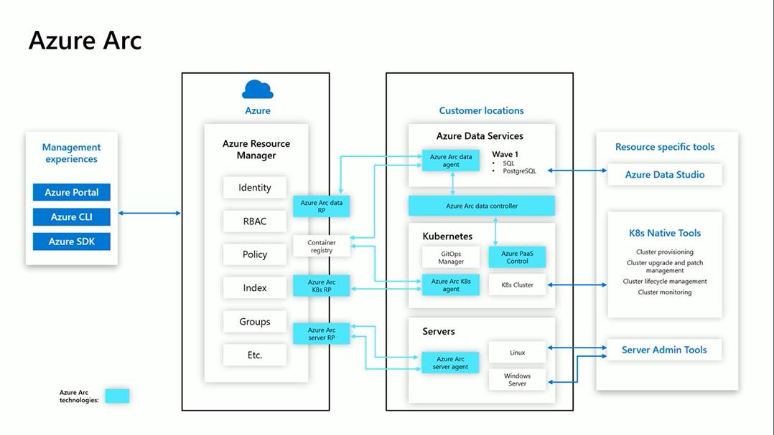

Slide 60
Resources
ARM template reference - https://docs.microsoft.com/en-us/azure/templates/
Authoring ARM templates - https://docs.microsoft.com/en-us/azure/azure-resource-manager/resource-group-authoring-templates
Azure CLI - https://docs.microsoft.com/en-us/cli/azure/resource?view=azure-cli-latest
Azure Resource Manager tools for VS Code - https://marketplace.visualstudio.com/items?itemName=msazurermtools.azurerm-vscode-tools
Butter - https://thecloudtheory.github.io/Butter/

Slide 61
Thank you! @Kamil_Mrzyglod kamil@thecloudtheory.com https://github.com/TheCloudTheory/Presentations

